Slide 1

Cybersecurity Attacks Project
Analysis & Visualization

Slide 2




Meet Our Team
Youssef Ahmed
Python(Data cleaning
& preprocessing)
Ahmed Gamal
Python(Preprocessing) SQL(Validation and extra analysis)
Rabie Taha
Power Bi
Youssef A.Elhalim
Power Bi
Under supervision of : Dr.Doaa Mokhtar

Slide 3
Overview
Introduction
Challenges and Solutions
Data Cleaning and Preprocessing
Questions and their Answers
Performing Validation and More analysis using SQL
Driving Insights

Slide 4
Introduction
Cybersecurity Importance:
In today’s digital world, cybersecurity is a major concern for organizations worldwide.
Increased Threats:
With the rise of online services and interconnected networks, cyber-attacks are becoming more frequent and sophisticated.
These attacks pose serious risks to sensitive data and operations.
Project Focus:
This project analyzes a comprehensive cybersecurity dataset.
The goal is to uncover key insights into network vulnerabilities, attack patterns, and the effectiveness of security measures.

Slide 5
Challenges and Solutions
Challenges
Limited Knowledge of Cybersecurity in the Team:
The team initially lacked sufficient knowledge in cybersecurity, requiring us to study and learn about the field to better understand and analyze the data. Dealing with Missing Values:
There were many missing values in the dataset, which we had to handle by replacing or imputing them to maintain the integrity of the analysis.
Solutions
We start to search on the internet to know more about the data and the cybersecurity field , This helps us to understand the dataset features and driving insights from it.
Knowing more about the dataset made it easy to figure what is the best way to handle missing values

Slide 6
Data Cleaning And Preprocessing
In this step, We used Python to deal with the dataset and we made the following actions:
Loading the dataset
Dataset basic exploration
Check for missing & Duplicated values to handle them
Handle the missing values with what is appropriate for each of them
Extracting Features & Creating new ones
Performing a last check to our data to make sure it’s ready for the analysis
Driving some visuals to reach some conclusions
You can access the Colab Notebook through this link: Click here

Slide 7
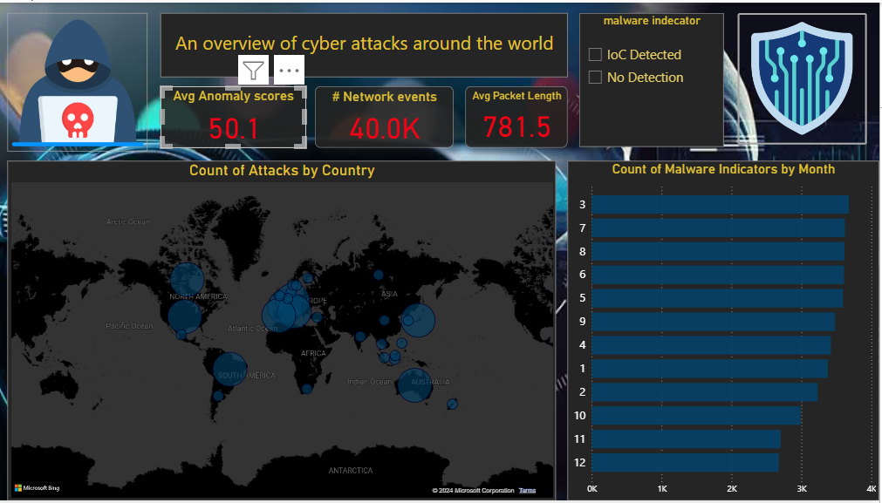
Questions and their Answers(1)
Which countries have the highest count of cyber attacks, and what insights can be drawn from this geographic distribution?
How many malware indicators were detected over the past months, and what trends can be observed in their frequency?

Slide 8
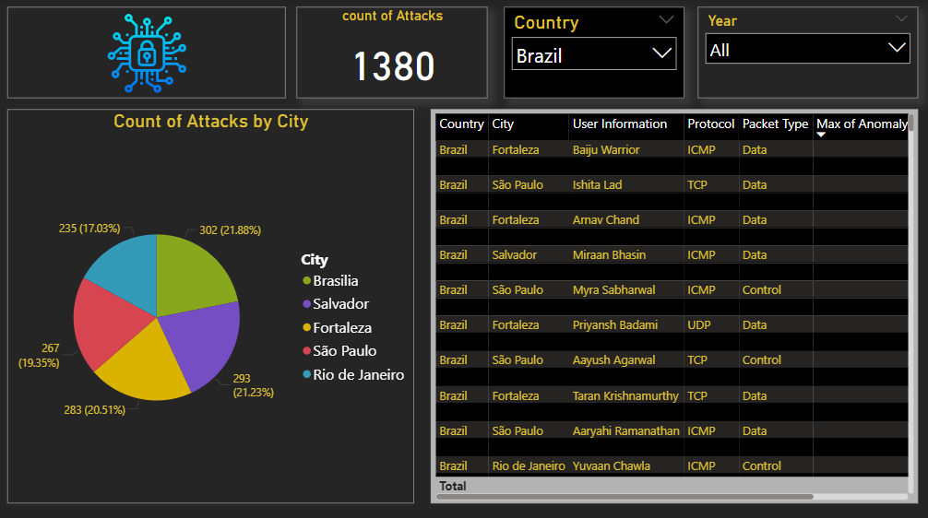
Questions and their Answers(2)
What is the total count of attacks recorded in the countries, and how does this figure relate to the total number of attacks across all cities?
What insights can be drawn from the user information associated with each attack, particularly regarding the users from each city?

Slide 9
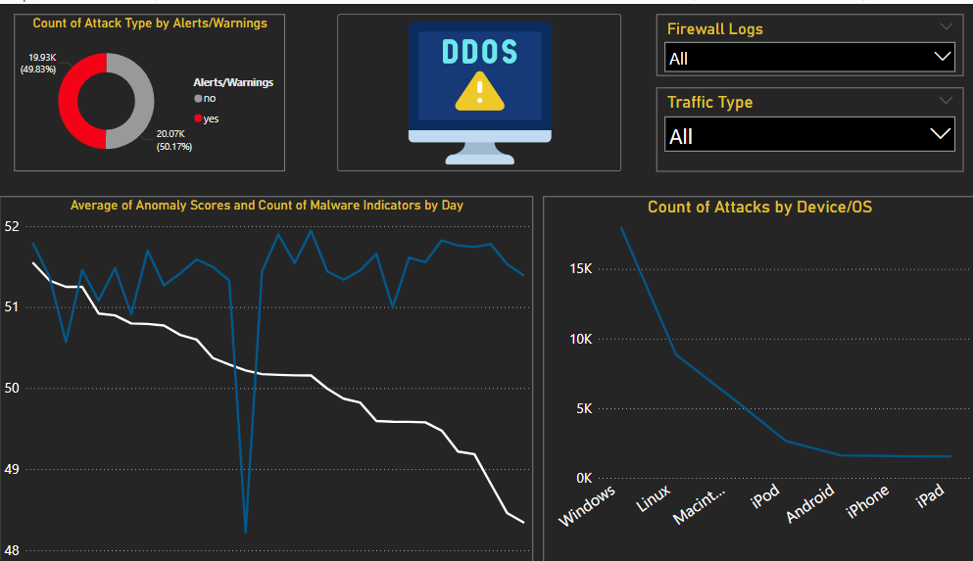
Questions and their Answers(3)
What is the daily trend of anomaly scores, and how do they correlate with the count of malware indicators detected? On which days do the highest anomaly scores occur, and do those days show an increase in malware indicators?
Which devices or operating systems are most frequently targeted by attacks?

Slide 10
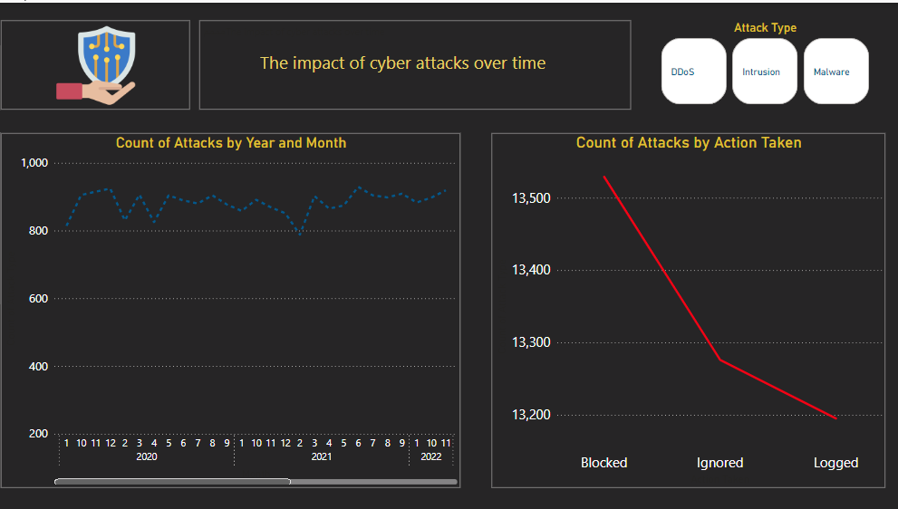
Questions and their Answers(4)
How has the number of attacks changed over the years and months? Are there any specific months or years that show a spike in the number of attacks?
Which actions (e.g., blocked, logged, ignored) are most frequently taken in response to attacks?

Slide 11
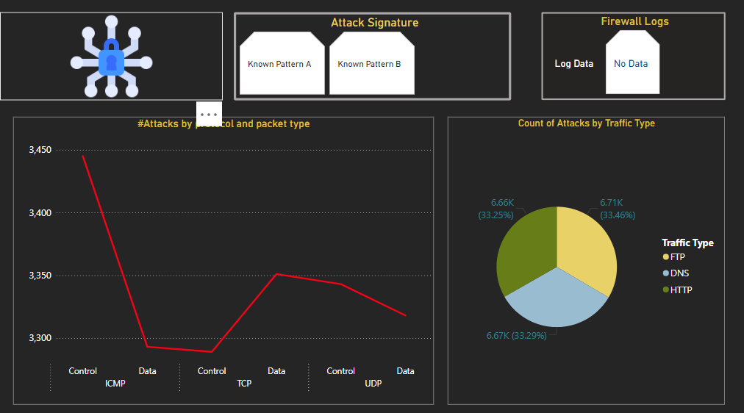
Questions and their Answers(5)
Which protocols (e.g., TCP, UDP, ICMP) are most commonly used in attacks?
Is there a specific packet type (e.g., data, control) associated with the majority of attacks?
Are there any patterns in protocol usage based on specific firewall logs or attack signatures?

Slide 12
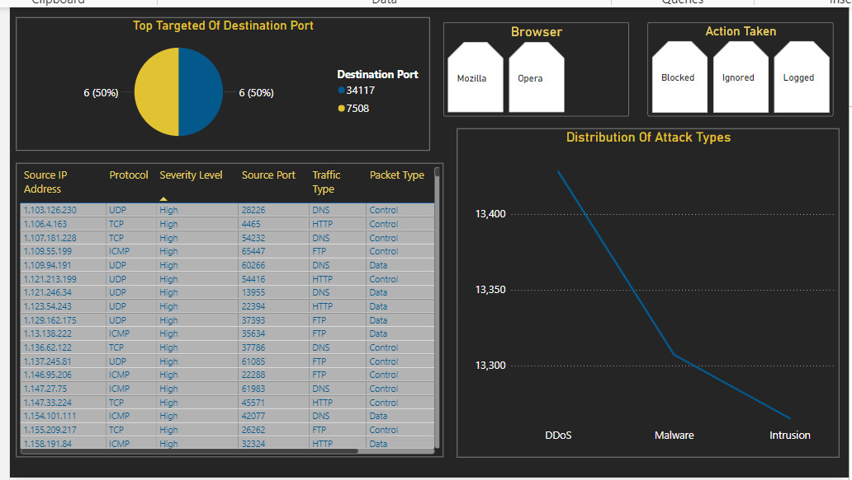
Questions and their Answers(6)
Which destination ports are most frequently targeted in the attacks?
What is the distribution of attack types?

Slide 13
Performing Validation and more analysis using SQL
Creating a database called cybersecurity and loading the dataset into it
Calculate Average Anomaly Scores (Validation)
Count of Network Events (Validation)
Calculate Average Packet Length (Validation)
Count of Malware Indicators by Day (analysis)
Average Anomaly Scores by Day (analysis)
Count of Attacks by Year and Month (analysis)
Top Targeted Destination Ports (analysis)
Average Packet Length by Attack Type (analysis)
Count of Attacks by Traffic Type (analysis)

Slide 14
Driving Insights(1)
The total number of attacks by country can help identify how different regions or cities within the same country compare in terms of attack frequency. A particular city might have vulnerabilities in their cybersecurity infrastructure or might be frequent targets due to political, economic, or technological factors.
User information associated with each attack may reveal patterns such as the types of users or businesses targeted in different cities. For instance, cities with more corporate or government infrastructure might show a higher volume of sophisticated attacks aimed at large organizations.
A correlation between high anomaly scores and malware detection can suggest a strong relationship between the severity of network activity anomalies and the presence of malicious software.
By analyzing the devices or operating systems targeted, you can identify which platforms are most vulnerable. For instance, if Windows systems are frequently targeted, it may indicate that attackers exploit specific weaknesses in that OS.

Slide 15
Driving Insights(2)
By analyzing which actions (e.g., blocked, logged, ignored) are most frequently taken, you can evaluate how prepared your systems are for mitigating attacks. A high frequency of blocked actions might indicate strong defenses, while a large number of logged or ignored attacks could suggest areas where active defense mechanisms are lacking.
Analyzing which protocols (e.g., TCP, UDP, ICMP) are most frequently used in attacks can reveal common methods attackers use to penetrate networks. For example, a high prevalence of TCP-based attacks may indicate that attackers exploit specific vulnerabilities in TCP connections.
Analyzing the destination ports most frequently targeted by attacks can help identify common entry points that attackers attempt to exploit. For instance, if a particular port is targeted repeatedly, it could indicate a known vulnerability associated with services running on that port.

Slide 16
THANK YOU
FOR REACHING THE END

